Slide 1
Characterizing mammalian piRNA precursors
Christian Roy
Biochemistry Chalk talk
Moore/Zamore Labs
11/04/2011

Slide 2

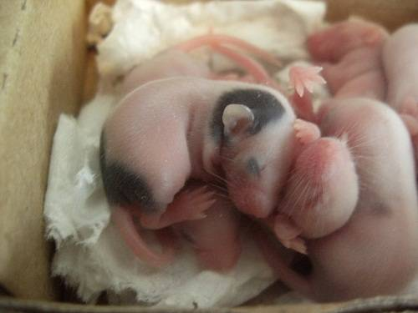
The importance of piRNAs
Sterility is common phenotype to all known pathway mutants
Human SNPs in Piwi proteins have been associated with male infertility
Especially in mammals, piRNA function in maintaining fertility largely unknown
Piwi

Slide 3
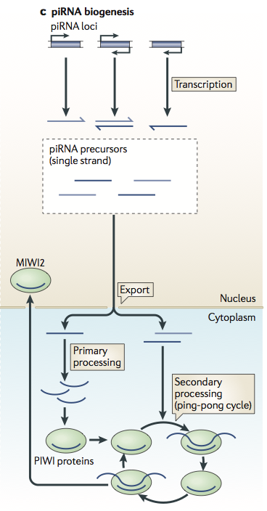
Features of mammalian piRNAs
Notes:
Median for mRNAs is ~1kb
Median for piRNA clusters is ~8kb nt
Describe boxplot?
Whiskers are Q1 – 1.5 * IQR and Q3 + 1.5 * ITR

Slide 4
Features of mammalian piRNAs
piRNA clusters are very long
Length in nt
mRNAs
piRNA
clusters
Features of a piRNA
23-30 nt small RNA
5’ Uridine
2 O-methylation on 3 end
Dicer independent
Binds a Piwi protein
*Map to transposons*
Notes:
Median for mRNAs is ~1kb
Median for piRNA clusters is ~8kb nt
Describe boxplot?
Whiskers are Q1 – 1.5 * IQR and Q3 + 1.5 * ITR

Slide 5

Cluster expression is dynamic
Xin Li, PhD
Zamore Lab
Jia Xu, PhD Bioinformatics Core
Notes:
The pachytene stage, also known as pachynema, from Greek words meaning "thick threads",[1]:27 is the stage when chromosomal crossover (crossing over) occurs. Nonsister chromatids of homologous chromosomes randomly exchange segments over regions of homology. Sex chromosomes, however, are not wholly identical, and only exchange information over a small region of homology. At the sites where exchange happens, chiasmata form. The exchange of information between the non-sister chromatids results in a recombination of information; each chromosome has the complete set of information it had before, and there are no gaps formed as a result of the process. Because the chromosomes cannot be distinguished in the synaptonemal complex, the actual act of crossing over is not perceivable through the microscope, and chiasmata are not visible until the next stage.[citation needed]

Slide 6
An example piRNA cluster
Chromsome 17
Cluster #1
small RNA
Poly(A) RNA-Seq

Slide 7
Precursor transcripts are germline specific
RNA Abundance from different RNA-Seq libraries

Slide 8
Evidence of contiguous precursor transcripts
Precursor transcript
flamenco – 200 kb
Do precursor transcripts exist as a contiguous piece of RNA?
Adapted from: Brennecke J, Aravin AA, Stark A, et al. Discrete small RNA-generating loci as master regulators of transposon activity in Drosophila. Cell. 2007;128(6):1089-1103.

Slide 9
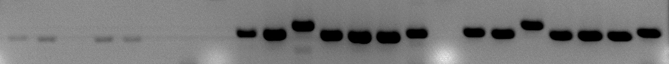
RT-PCR analysis of precursor transcripts
1
2
3
4
5
7
RT
6
Mouse Testes RNA after DNAse treatment
-RT
+Primer
+RT
+Primer
+RT
-Primer
(nt)
200
100
1 2 3 4 5 6 7
Notes:
“Current technology is unable to prove continuity of a long transcript – for example if we use PCR to show amplicons are on same transcript, depending on the primer in red, essential control, rarely done, saw these results
RT Will not go long enough and is not sufficiently primer depend,
Testing a single continuous precursor transcript
This is a good thing that RT-PCR Doesn’t work – for my case at least
How can you expect RT to go for over 40 kB?!

Slide 10
SeqZip
An RT-free methodology to examine RNA sequence content and connectivity
Notes:
Mention issues of Bias and number of ligaiton sites

Slide 11
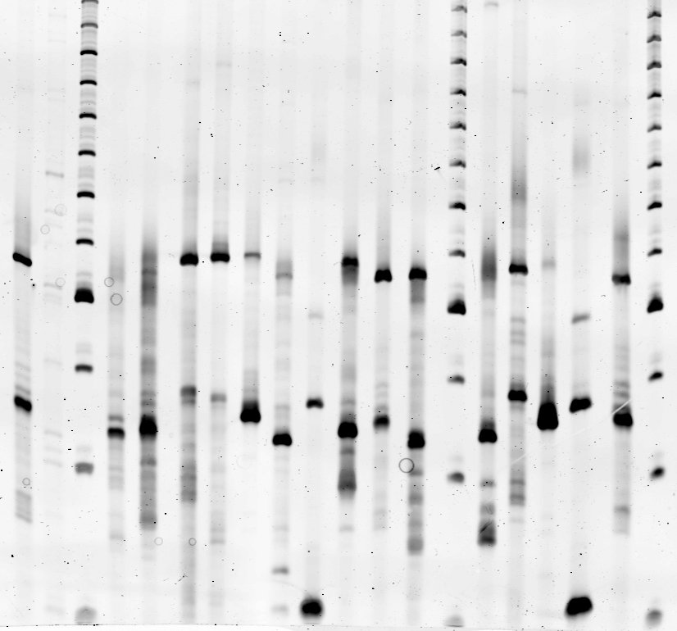
SeqZip analysis of piRNA precursor 1
Loop size in kb ->
5.1
5.2
6.0
5.5
6
4.6
6.7
A
B
C
D
E
F
G
10 kb
(nt)
A B C D E F G
175
150
125
Notes:
Have a ‘Vast Hugeness’ needed to work in pieces
Discussed missed attempts to “GO FOR HOMERUN”

Slide 12
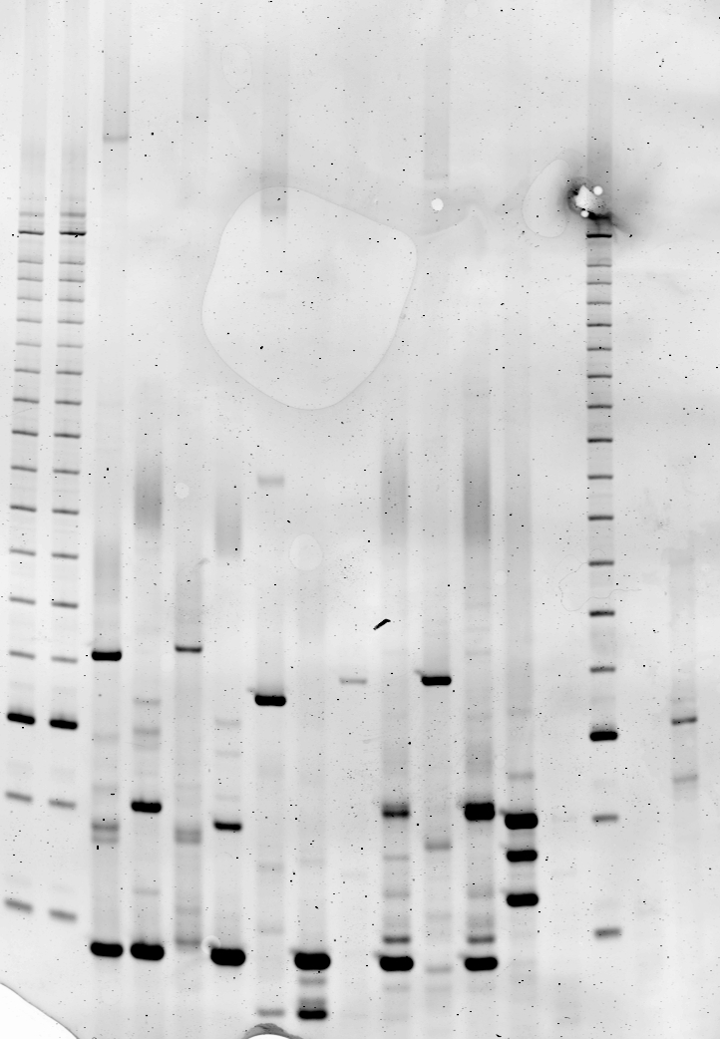
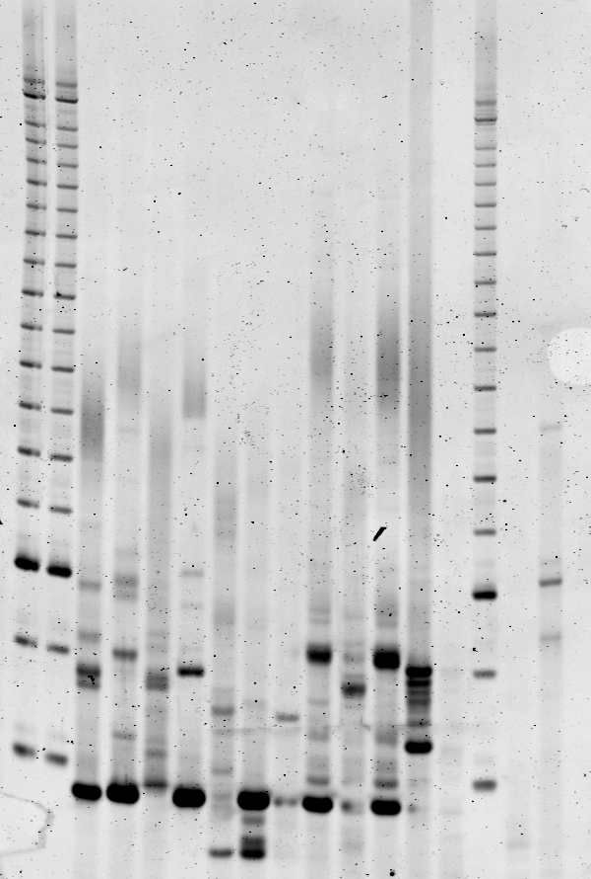
SeqZip analysis of a different precursor
10 kb
Loop size in kb:
6.3
5.1
5.1
4.9
3.1
A
B
C
D
E
Mouse teste RNA
Mouse Spleen RNA
(nt)
A B C D E
A B C D E
175
150
125

Slide 13
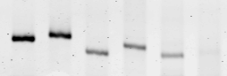
Product abundance decreases with loop length
Loop size in kb:
5.1
5.2
6.0
5.5
6
4.6
6.7
A
B
C
D
E
F
G
5k 6k 7k 8k 9k 10k
+1kb increments
(nt)
A B C D E F G
175
150
125

Slide 14
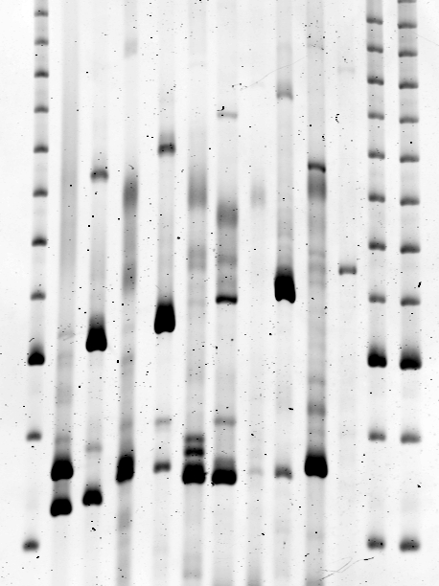
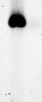
SeqZip connects ends of a long mRNA
Dst gene:
Dst mRNA:
>23 kb
5.0
4.9
5.1
5.2
2.7
A
B
C
D
E
>22 kb
A:E
(nt)
A B C D E A:E
175
150
125

Slide 15
Status of SeqZip precursor analysis
RT-PCR can not demonstrate continuity of precursor transcripts
SeqZip indicates continuity of at least 5 kb segments and up to a 10 kb segment
Have yet to demonstrate continuity between the suspected 5’ and 3’ of a precursor
Methodology does demonstrate connectivity >23 kb for a known mRNA

Slide 16
Precursors are spliced
small RNA:
Poly(A) RNA-Seq:

Slide 17
Precursors are spliced
small RNA:
Poly(A) RNA-Seq:
small RNA:
Poly(A) RNA-Seq:

Slide 18
EST evidence for splicing
small RNA:
Poly(A) RNA-Seq:
Reported ESTs:
BU961054
CR518684

Slide 19
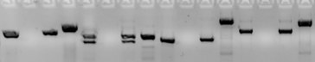
RT-PCR confirms spliced precursors
Intron 1 | Intron 2 | Intron 3 | Intron 4
+RT | -RT | -Pri | G | +RT | -RT | -Pri | G | +RT | -RT | -Pri | G | +RT | -RT | -Pri | G
+RT = + Reverse transcriptase
-RT = - Reverse transcriptase
-Pri = No RT primer added
G = Genomic DNA template

Slide 20
Non-genome mapping piRNAs map to junctions
piRNA density:
Genome
mapping reads
RNA-Seq :
Junction reads
Non-genome
mapping reads
piRNA density:
Splice junction:
piRNA sequence reads

Slide 21
Precursor introns have lower piRNA density
Median of read count at specific base
sum of all counts for whole region
N=32
Notes:
Junctions that
1) fall within clusters
2) Do not overlap annotated refSeq Genes
3) have more than 1 supported splice junciton read
Gone in Mutant

Slide 22
Precursor introns have lower piRNA density
Median of read count at specific base
sum of all counts for whole region
N=32
Notes:
Junctions that
1) fall within clusters
2) Do not overlap annotated refSeq Genes
3) have more than 1 supported splice junciton read
Gone in Mutant

Slide 23
Non-genome mapping piRNAs map to junctions
Median of read count at specific base
sum of all counts for whole region
N=32
Not so in pathway mutants that block transcription of precursors!
Notes:
Gone in mutant!

Slide 24
Summary
SeqZip indicates precursor transcripts exist as at least 5 kb segments
SeqZip can loop out >23 kb of an mRNA
Precursor transcripts undergo splicing
piRNA are derived from spliced precursors

Slide 25
Future goals
Modifications to SeqZip protocol to increase loop limit
Deep sequence the 5’ end of precursors
Identify more introns within cluster using deeper or more even RNA-Seq coverage

Slide 26
Thanks!
Moore Lab
Melissa J Moore
Laureen Murtha
Rina Paladino
Jing Yan
Weijun Chen
Inna Shcherbakova
Victor Serebrov
Alper Kucukural
Akiko Noma
Alicia Bicknell
Lingtao Peng
Guramrit Singh
Eric Anderson
Erin Heyer
Kelly Limoncelli
Danny Crawford
Tiffany Lopes
Luis Gustavo Morello
Can Cenik
Ami Ashar
Emiliano Ricci
Blandine Mercier
Zamore Lab
Phillip D Zamore
Xin Li
Gwen Farley
Cindy Tipping
Alicia Boucher
Tiffanie Covello
Zhao Zhang
Stefan Ameres
Timothy Chang
Bo Han
Carlos Fabian Flores
Ryuya Fukunaga
Elif Sarinay
Keith Boundy
Desiree Boltz
Jogender Singh
Liang Meng Wee
Chengjian Li
Alicia Boucher
Tracey Lincoln
Jennifer Broderick
Wes Solomon
Wei Wang
TRAC
Zhiping Weng
Scot Wolfe
Job Dekker
Bioinformatics Core
Jia Xu

Slide 28
General Comments
Do not start with ‘SO’
Start with piRNAs (Why I should care)
Compare length of clusters to something audience knows
Titles on 1 line – make them a conclusion
Always have the title in same place!
All fonts are Helvetica Neue
Do not tell what you are to tell – just tell!
Tags = ‘Sequence Reads’
Change RPKM to RNA Abundance per KB
Change all numbers to KB with 1 sig digit

